Slide 1
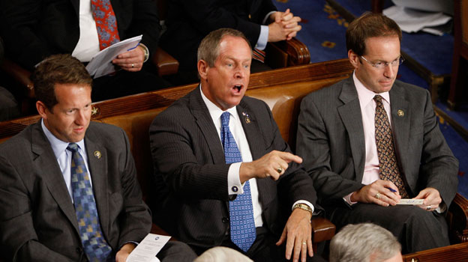
Providing the E in G x E x M (well, most of the E)
daryl herzmann
@akrherz
Agronomy 600B
5 Feb 2020
AP Photo

Slide 2
Genetics (G) x Environment (E) x Management (M)
Dr Jerry Hatfield et al review paper (Agronomy Journal 2015) introduces M into the G x E equation to increase actual yield vs just yield potential.
“The rationale for a departure from the classic G × E interaction is to highlight the effects of climate variability on the environment factor, and the opportunities for management to enhance performance of genetic resources under varying environmental conditions.”
Knowledge of the Environment can inform Genetic and Management decisions. Perhaps then, G = f(M)… and M = f(G, E)…

Slide 3
My presentation goals
Inform of resources available for the provision of E
Discuss environmental variables relevant to G x E x M
Air Temperature, Humidity, and Wind
Precipitation
Solar Radiation
Soil Moisture and Temperature
Scare you with the complexities of using such data at field scale so to
Encourage you to stop by my office to discuss your E needs and then to
Write me into your grants so that I can stick around here!
(or I take food donations from poor grad students, postdocs, and assoc profs)

Slide 4


Providing (most of) the E Iowa Environmental Mesonet
https://mesonet.agron.iastate.edu (Google: “IEM ISU”)
ISU Agronomy project since 2001
“Mesonet” is a meteorology term describing a network of observations on a spatial scale ~10s km
Crazy website with all kinds of apps and portals to get lost in and cry over
Please please please, the main point for today, talk to me about E:
Tweet me! @akrherz
Call me! 515 294 5978
Stop by my office! 3027 Agronomy
Email me! akrherz@iastate.edu
https://tenor.com

Slide 5
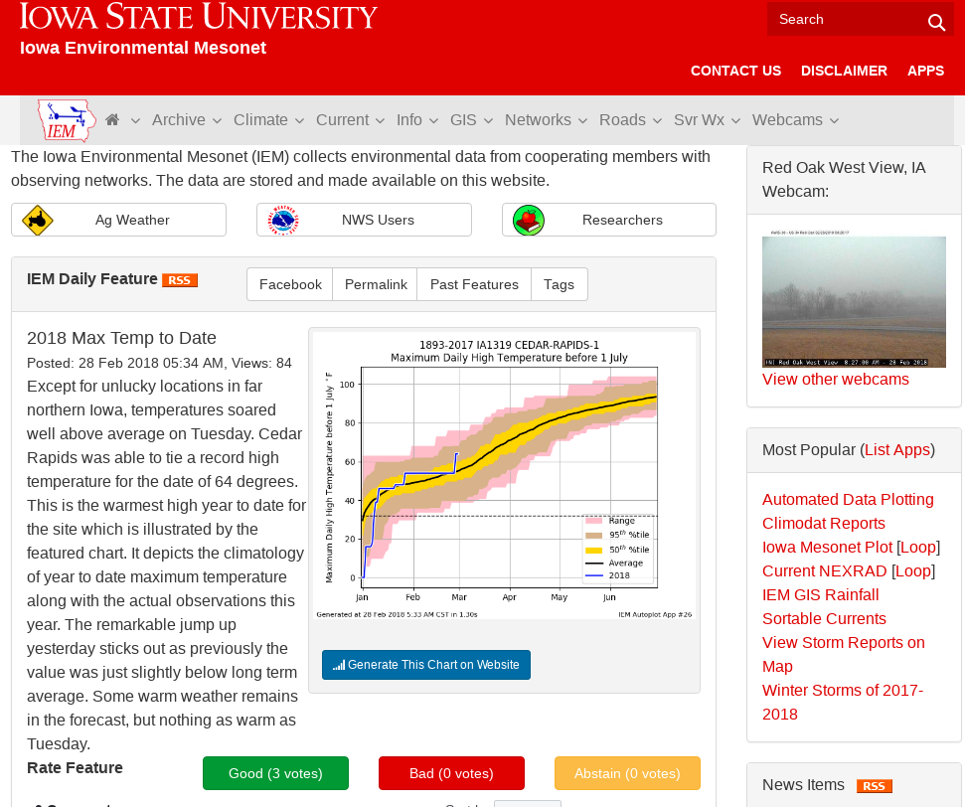
https://mesonet.agron.iastate.edu (Google: “IEM ISU”)
The website aggregates data from many different data sources.
Data is generally organized by acronym heavy “Networks”,
ISU Soil Moisture Network is one such network.
“Daily Feature” highlights some relevant and deep linked plot each day.

Slide 6
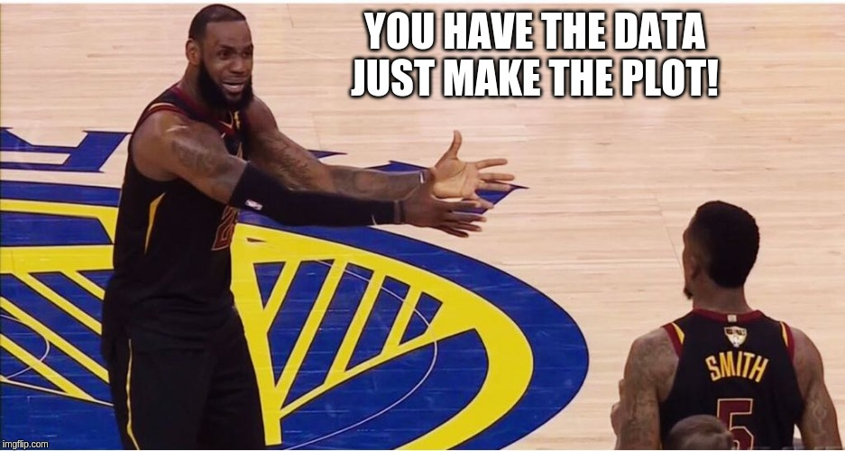
Website does more than just provide E data
So you download some data from my fancy pants website in Excel format, now what?
You don’t want to become an Excel pivot table expert.
Your STAT 201 class was at 8 AM.
Your friend that knows R is busy.
So there’s an “Autoplot” app for that…
https://imgflip.com

Slide 7
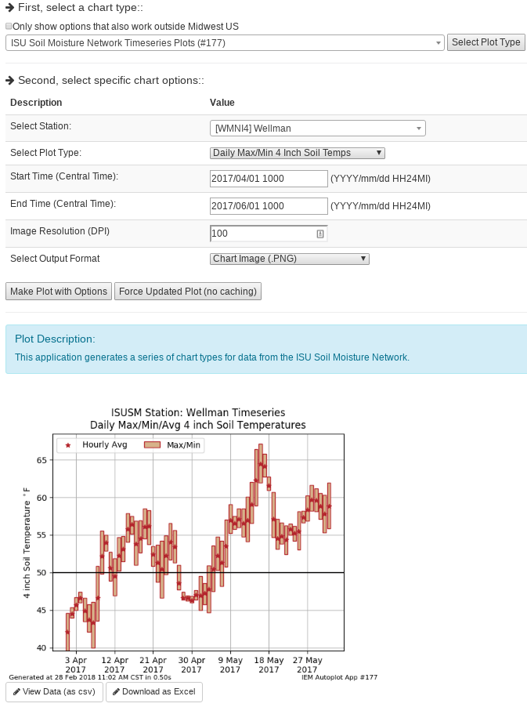
IEM
“Automated Data Plotting”
Select Plot Type (207 of them currently)
Select Plot Options
Hopelessly Terse Description
Custom Generated Plot
Download Raw Data (Excel) or CSV

Slide 8
IEM Aggregated Networks
Acronym / Title | Domain | Description
ASOS / AWOS | Global | General classification of Airport weather stations operated by the FAA, NWS, DoD, and state DOTs.
CoCoRaHS | Iowa | Citizen science reporting “daily” snowfall, snow depth and precipitation.
NWS COOP | US | National Weather Service Cooperative Observers reporting “daily” high and low temperatures, precipitation, and snowfall.
DCP / HADS | North America | General grouping of many different types of sensors that focus on hydrology.
ISU Soil Moisture | Iowa | Iowa State operated network of weather stations focused on Agriculture weather data needs.
NLAE Flux | Ames | Advanced monitoring stations by the USDA NLAE monitoring various fluxes from agricultural landscapes.
RWIS | US | DOT Roadway Weather Information Systems monitoring weather and pavement state.
SCAN | Midwest | USDA Soil Climate Analysis Network
Other | Iowa | Various other stations.

Slide 9
Which network should I use?
Data Need | Time Interval | Recommendation
“Daily” High/Low Temps + Precipitation | Daily | NWS COOP IEM “Long Term Climate” / “Climodat”
Air Temperatures + Precipitation (not snow) | Hourly | ASOS/AWOS + ISU Soil Moisture
Wind | Daily + Hourly | ISU Soil Moisture ASOS / AWOS (Airport weather stations)
Solar Radiation | Daily + Hourly | ISU Soil Moisture
Soil Temperature/Moisture | Daily + Hourly | ISU Soil Moisture / SCAN
Humidity | Daily + Hourly | ISU Soil Moisture / ASOS / AWOS

Slide 10
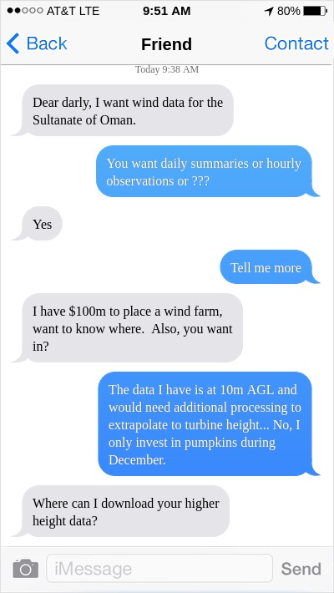
Do you know what you want?
What spatial and time scale are you at?
I want the wind speed for my “back 40” at 8 AM on 5 Jun 2019, when my spray drifted into the neighbor’s field.
I want climate district 2019 growing season precipitation to correlate with yield.
I want the 2-5 PM precipitation on 8 Aug 2019 to file a weather insurance claim for my festival.
I want within 1% accurate solar radiation (PAR) data for my crop growth model.
Building a website to support all the above is an untenable challenge to meet, but why not try!
http://iphonefaketext.com/

Slide 11
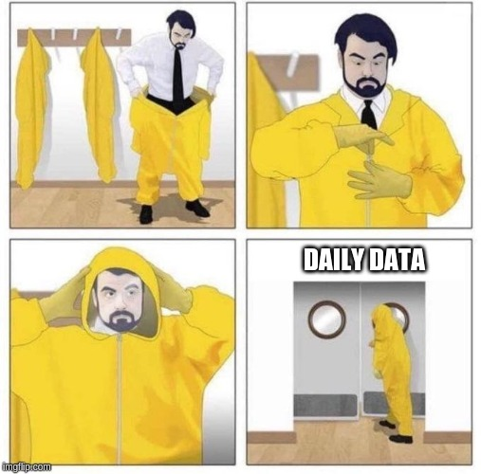
Data Variables to Discuss
Air Temperature, Humidity, and Wind
Precipitation
Soil Moisture/Temperature
Solar Radiation
http://imgflip.com

Slide 12
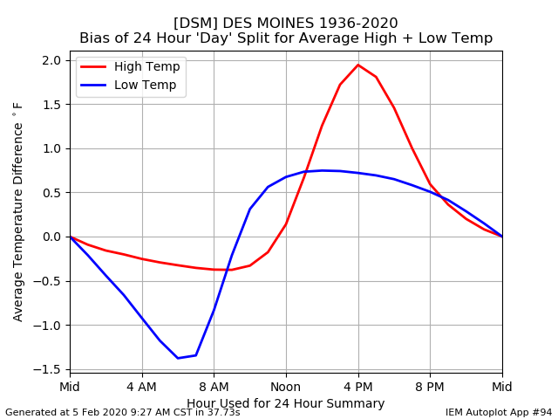
Daily Bias
Some “daily” data is a lie.
They are instead 24 hour interval values at some observation time other than midnight.
That observation time matters.
Web Link

Slide 13
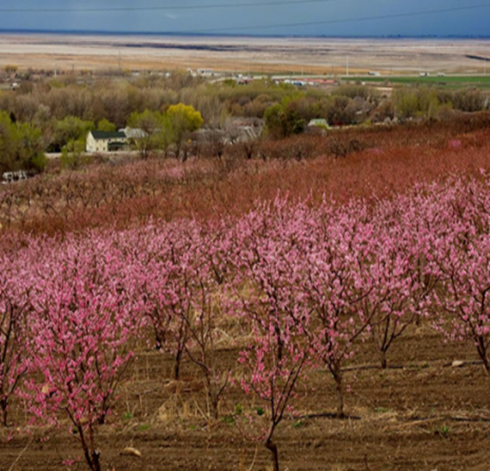
Understanding micro-climates
Subtle topography / elevation change makes a difference!
We don’t have enough sensors nor sensor sensitivity to measure this effect.
If you are studying agronomic variability at this scale, you likely need to consider that weather/climate varies too.
Photo: Dr Elywnn Taylor

Slide 14
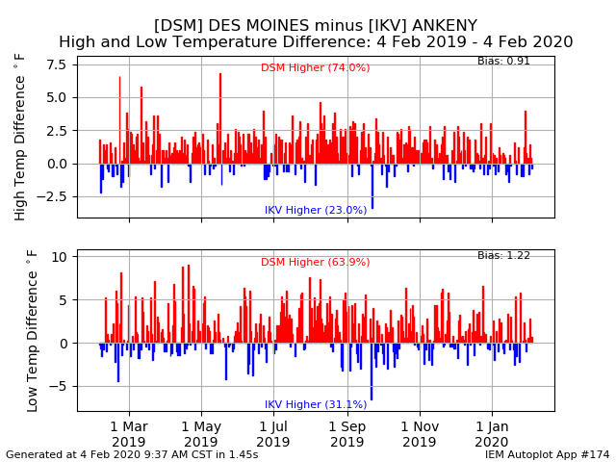
Urban Heat Island
Urban areas are generally warmer than rural due to albedo and heat holding capacity differences.
UHI is even noticeable in smaller Iowa towns.
Magnitude of this difference may not matter for your usage case.
Web Link

Slide 15
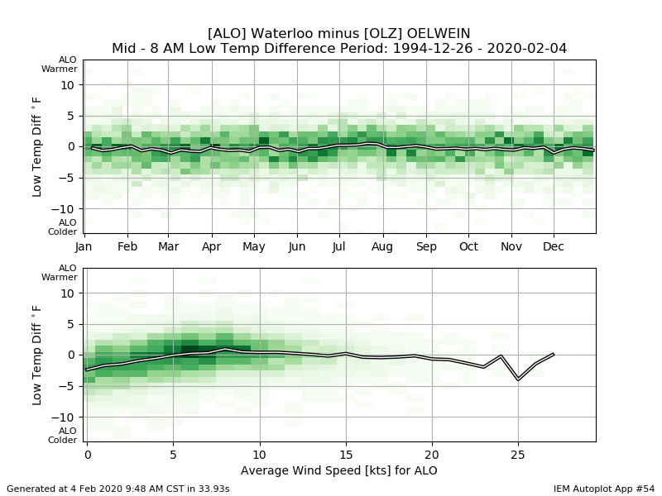
Soil Differences
Waterloo’s site has soil with larger sand content and will cool faster under light wind condition.
Web Link

Slide 16
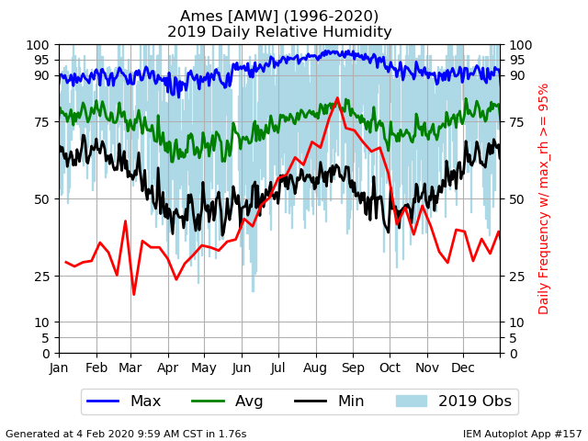
Relative Humidity
As the name implies, the value is relative.
On average, the lowest RH values happen in the spring/fall (black line).
Daily average RH is about the same in summer and winter (huh?)
Web Link

Slide 17
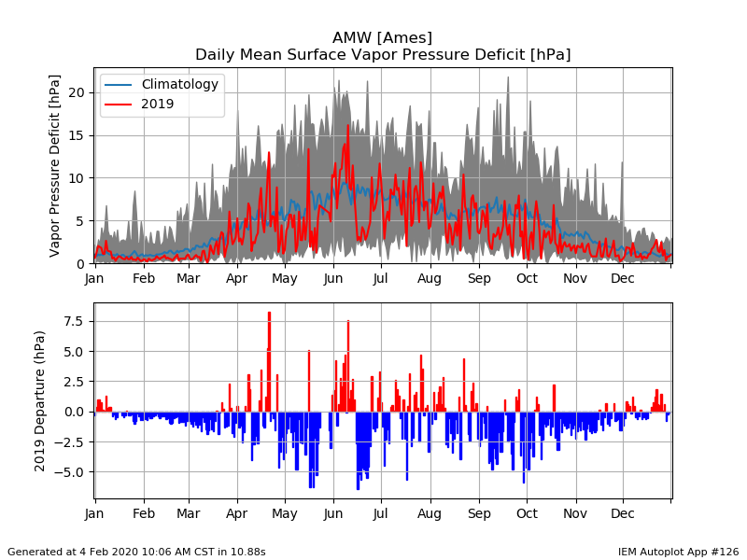
Vapor Pressure Deficit (VPD)
VPD is a more direct and comparable measure of humidity.
Air’s demand / pull of water vapor.
2019 values show a decreased demand from average.
Web Link

Slide 18
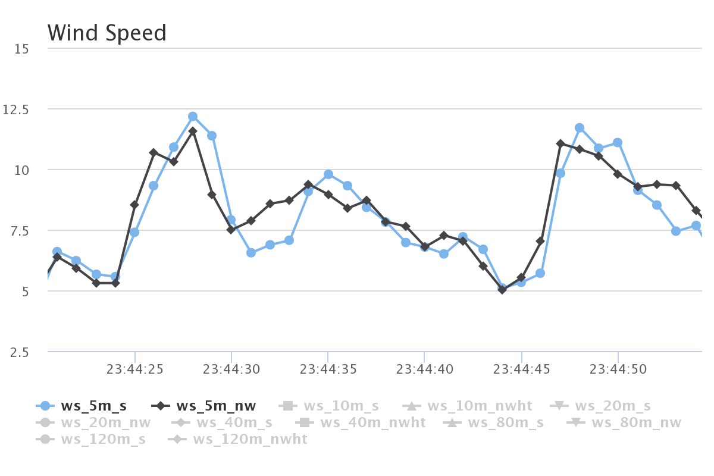
ISU “Tall Towers” 1 second interval Wind Speed [mps]
This entire plot is just 40 seconds of data!
Two sensors at same height, mounted at different directions on the tower. We also have 20 Hz data ☺

Slide 19
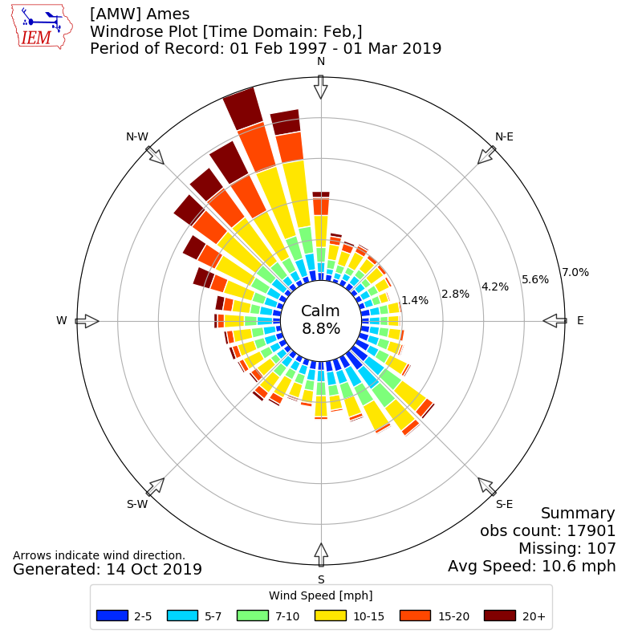
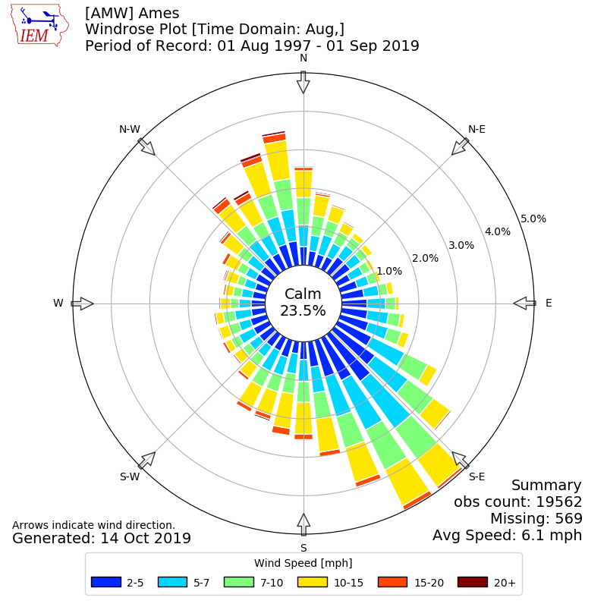
February
August
Web Link

Slide 20
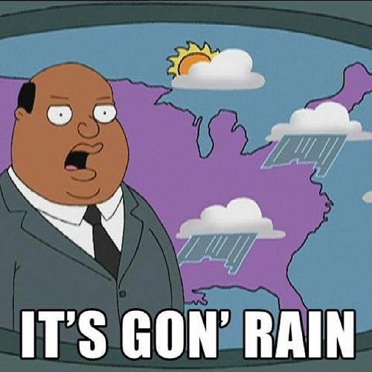
Data Variables to Discuss
Air Temperature, Humidity, and Wind
Precipitation
Soil Moisture/Temperature
Solar Radiation
http://memgenerator.net

Slide 21
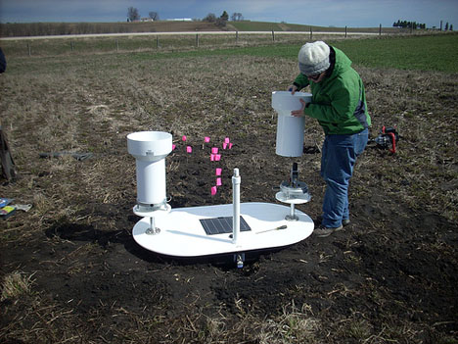
Precipitation Variability
Iowa Flood Center experiment with tipping buckets 3 feet apart
Found some cases of noticeable differences between these two gauges
In general case, which gauge is right? ☺
http://iowafloodcenter.org/notes-from-the-field-rain-gauges/

Slide 22
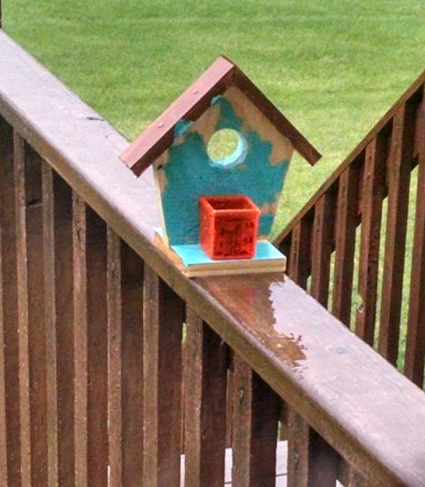
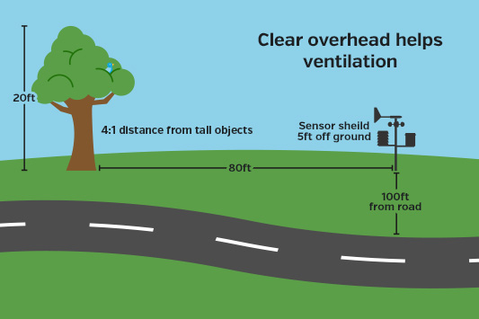
Bah, My weather station at my house is highly accurate!
daryl’s rain gauge at his house
https://www.wunderground.com/weatherstation/installationguide.asp

Slide 23
The answer to: “How much did it rain in Ames on 25 June 2010?”
IEM QC COOP | 0.00 | SchoolNet | 0.57 | CoCoRaHS | ??? | Stage IV | 0.22
ASOS | 0.13 | RWIS | 0 ? | ISUAG AgFm | 0.25 | NARR | 0.19
ASOS DSM | 1.11 | Lincoln Way | 0 ? | Others | 0.53 | TRMM | 0.51
ASOS DSM Hr | 0.33 | Ada Hayden | 0.93 | DMX 1hr | 0.30
ASOS 1min | 0.36 | H2O Trtment | 0.47 | DMX Storm T | 0.25
We simply average and get: 0.36176470588 inches! What precision!

Slide 24
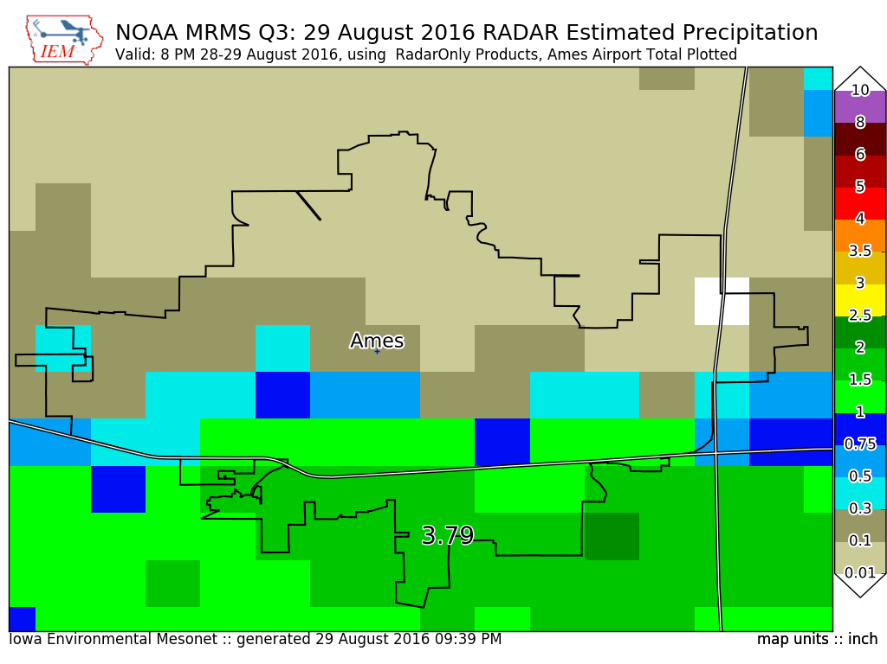
RADAR does not measure precip.
Plot Shown:
RADAR est: 1.50”
Airport Ob: 3.79”
Primary problem:
Earth is round!
Apply best science and at least try!
The IEM has several RADAR derived precip datasets.
Web Link

Slide 25

Welcome back to, Do you know what you want?
Do you care if the liquid equivalent of snowfall is measured?
You are stuck with ‘daily’ NWS COOP data.
Do you want snowfall and snow cover data?
Well, let us have a talk.
Do you want the yearly climatology to compare with an observation?
The longer the time scale, the safer you are and the further away distance you can use to find an available station. NWS COOP is great for this.
Do you want hourly data during the warm season?
ISU Soil Moisture and ASOS/AWOS will likely be OK, with some caveats.
Do you want two minute interval intensity information to do soil erosion modeling?
Sorry, the Daily Erosion Project owns many patents in this space.

Slide 26
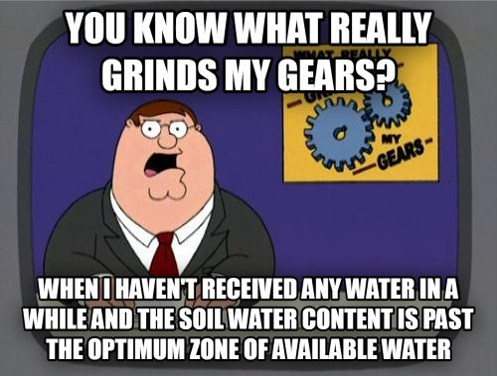
Data Variables to Discuss
Air Temperature, Humidity, and Wind
Precipitation
Soil Moisture/Temperature
Solar Radiation
Highly recommended website: wiki.ubc.ca

Slide 27
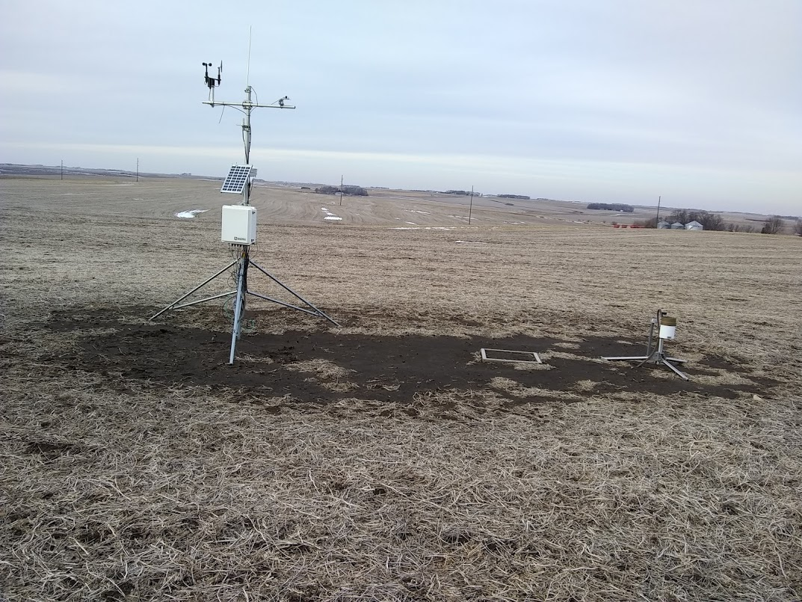
ISU Soil Moisture Station
Wind Speed
+ Direction
Solar Radiation
Solar Panel
Air Temp + Humidity
Tipping Bucket
Rain Gauge
Logger Enclosure
Bare soil for 4 inch
Depth Soil Temperature
12, 24, & 50 inch depth
Soil Temperature + Moisture

Slide 28
ISU Soil Moisture Caveats Galore
Only 12, 24, and 50 inch depth readings for moisture + temperature
4 inch soil temperature is not in the crop field
Sensors don’t work properly when soil is frozen
We’ve had issues with lightning knocking out sensors
Newly installed sensors need time to find equilibrium

Slide 29
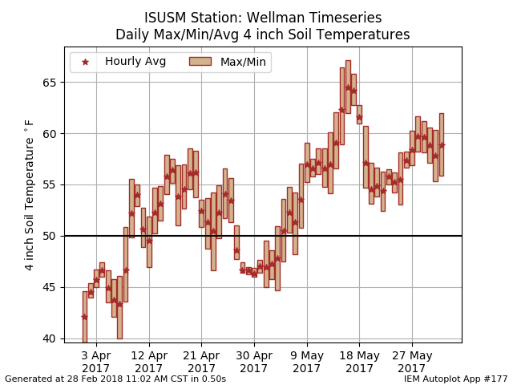
Web Link
Four inch depth soil temperatures are the most popular product from the network.

Slide 30
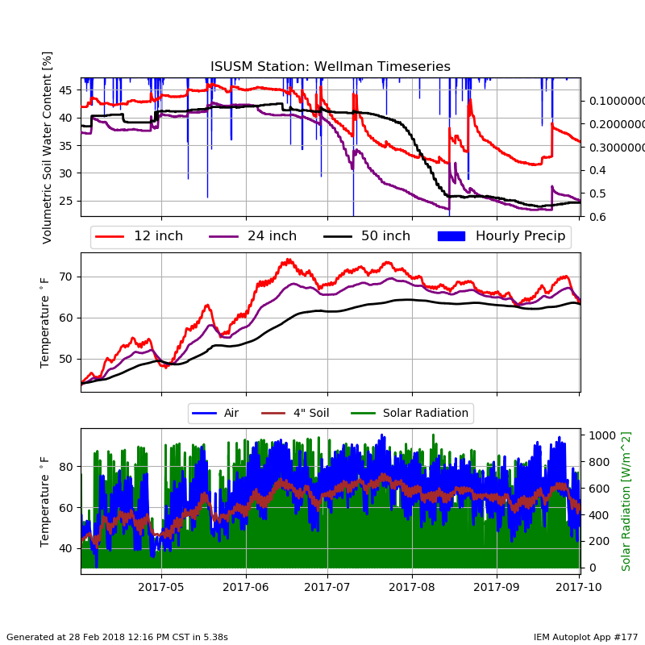
Web Link
Soil moisture data can be very informative! Though, not all plots are this pretty!
The lack of a soil moisture value at a shallower depth is a problem we hope to address with a new sensor.

Slide 31
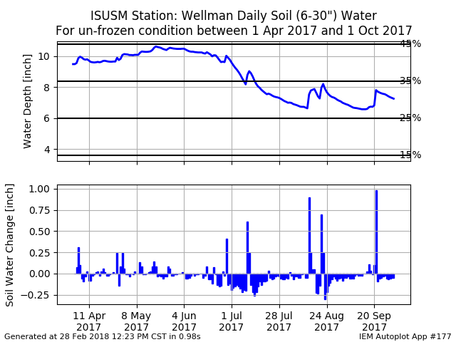
Web Link
Providing more meaningful SM data in relatable units has been a challenge.
Would love to collaborate with anybody interested in this topic, I have the data ☺

Slide 32

Data Variables to Discuss
Air Temperature, Humidity, and Wind
Precipitation
Soil Moisture/Temperature
Solar Radiation
BBC South East

Slide 33
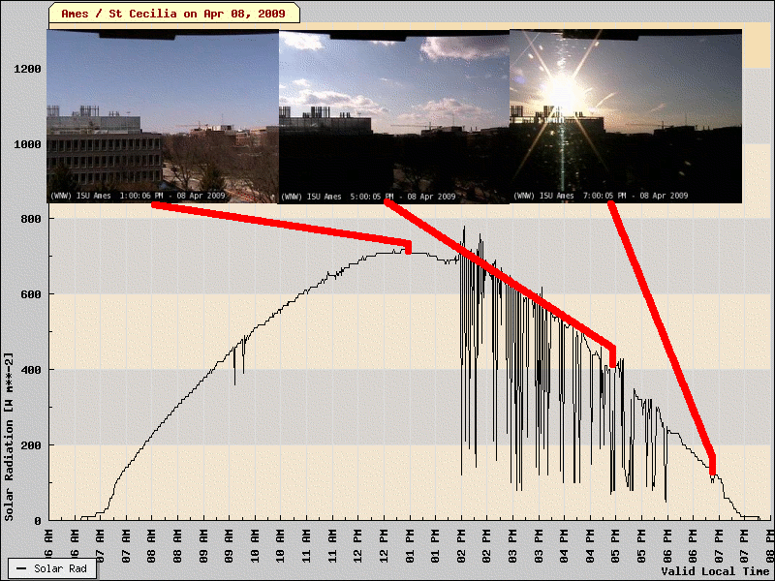
Clear vs Party Cloudy
One minute resolution data shows the impact of individual clouds.
Do you need to know this variability?
Web Link

Slide 34
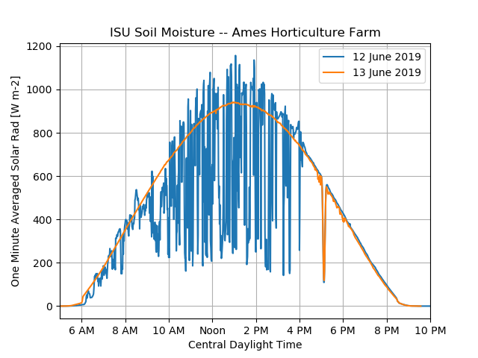
More radiation than during a clear day?
Gold Star for whomever knows what this is?
Web Link

Slide 35
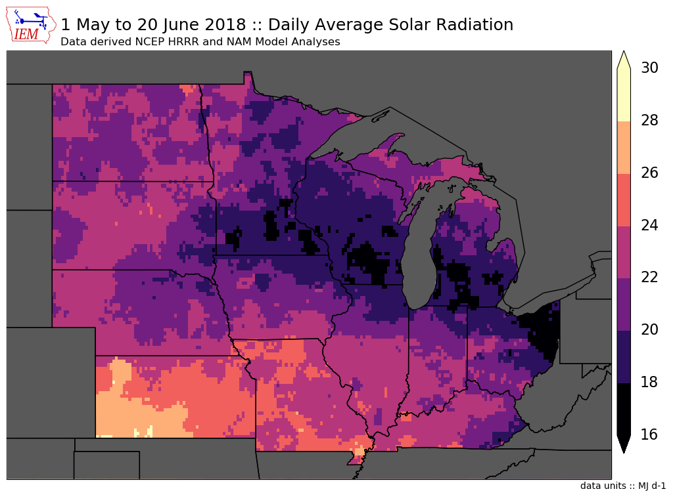
Model Provided
Solar Radiation
HRRR (realtime)
NAM (realtime)
NARR (delayed)
NASA MERRA2 (delayed)
This information has been merged with the NWS COOP data for download.
Web Link

Slide 36

Do I have time for more shameless promotion?
A significant goal of my project is to provide the needed E data for other projects to apply to their disciplines.
Like a utility, my project is simply providing electricity (the data) via a standard plugin (data formats) that others can use and treat like a black box if they want.
For more intensive and hopefully sponsored usage cases, custom interfaces and workflows are provided.
https://www.homestructions.com/

Slide 37


Supporting two large USDA CAP Projects
Dr Lori Abendroth and many, many collaborators
Custom data interfaces and custom data formats
Data Management
Other fun

Slide 38
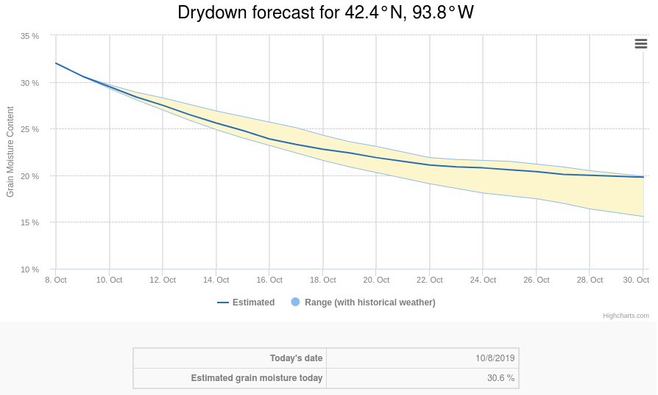
Corn Grain Drydown Tool
Provides a high resolution grid of data to drive a corn grain drydown model.
Tool runs on extension website and makes automated API calls to a web service running on the IEM website.
Web Link

Slide 39
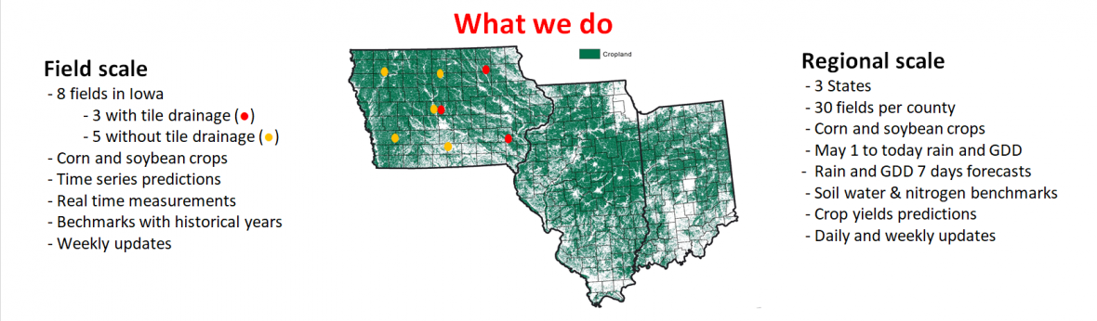
Forecast and Assessment of Cropping sysTemS (FACTS)
https://crops.extension.iastate.edu/facts

Slide 40
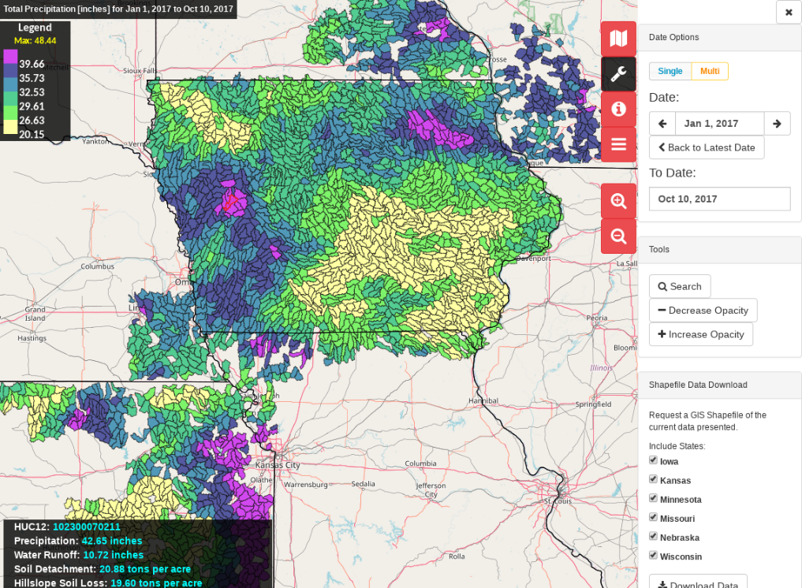
Daily Erosion Project: https://dailyerosion.org
Drs Rick Cruse and Brian Gelder
“Big data” project with a 17 year long TODO list.
Suite of tools and extensive processing to provide IEM E data to the soil erosion model WEPP to provide daily HUC12 estimates of soil erosion, water runoff, and other fields.
A sampling framework and a data schema called ACPF for scenario studies

Slide 41

OK, enough of my rambling…. Questions? https://mesonet.agron.iastate.edu “Info” Tab -> Presentations
3027 Agronomy
Twitter: @akrherz
akrherz@iastate.edu
515-451-9249

